Slide 1
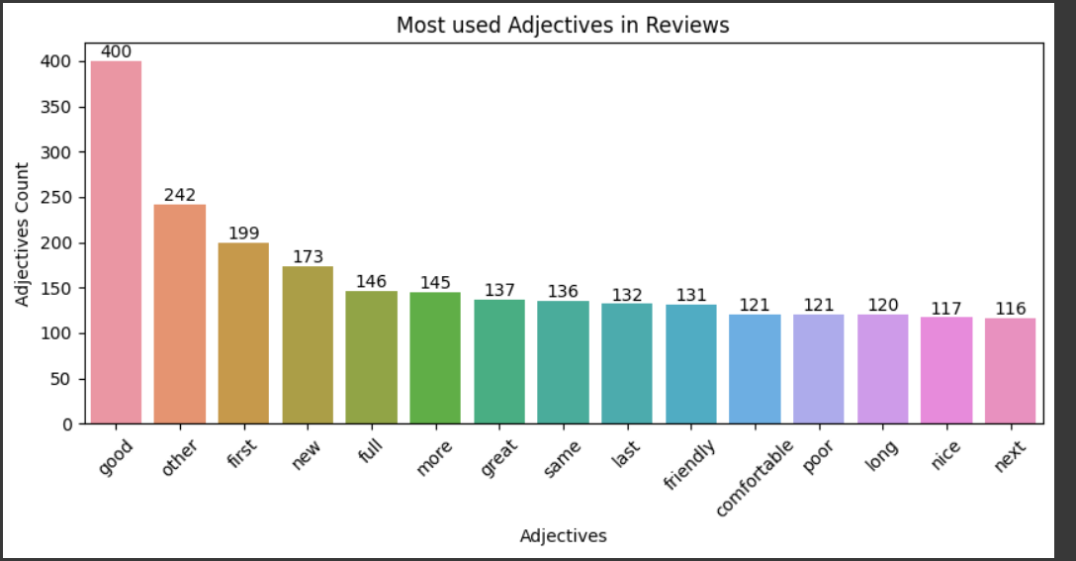
The most used adjectives in reviews are:
Good-400 times
First-199 times
New-173 times
Full-146 times
More-145-times
Good-400 times
First-199 times
New-173 times
Full-146 times
More-145-times

Slide 2
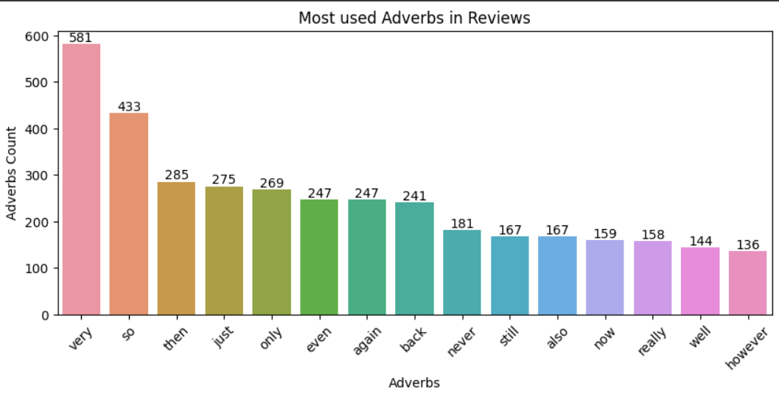
The most used Adverbs in reviews are:
So-433 times
Very-581 times
Then-285 times
Just-275 times
Only-269-times

Slide 3
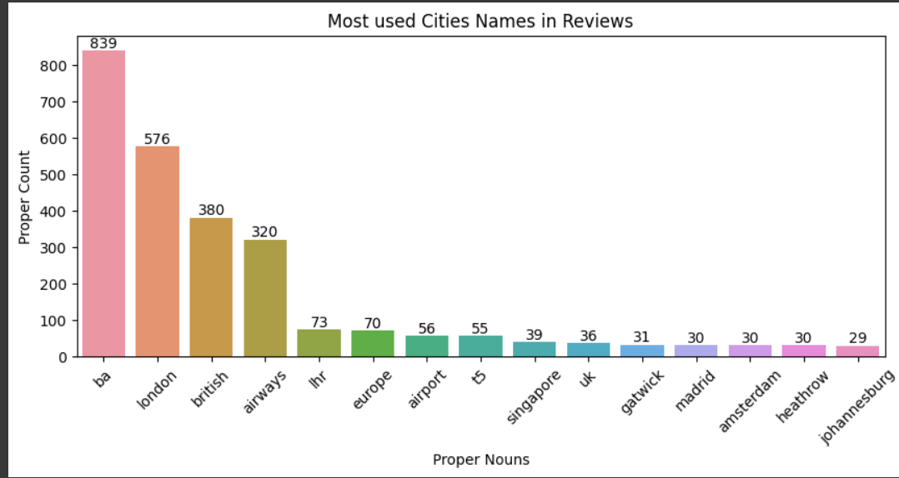
The most used Proper Nouns in reviews are:
London-576 times
British-380 times
Airways-320 times
Lhr-73 times
Europe-70 times

Slide 4
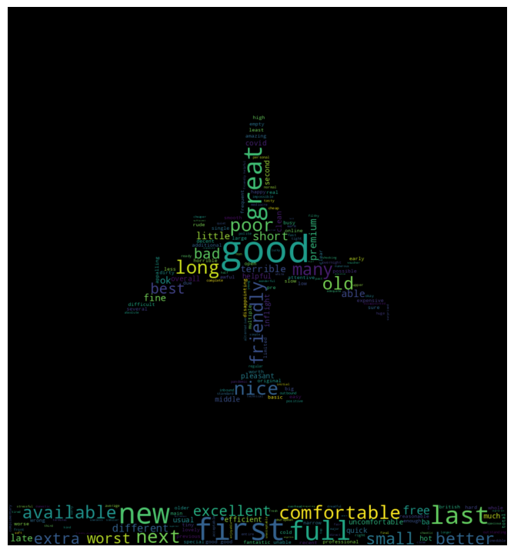
• Analyzed the dataset by extracting Adjectives, Adverbs, and Proper Nouns.
• "Good" was found 443 times in the dataset, indicating passengers' positive experiences with high-quality service, while "Poor" only occurred 120 times.
• The term "Late" was identified 86 times, highlighting an area where flight punctuality improvement may be needed.
• Noteworthy Proper Nouns included "London," "Europe," and "Singapore," with 639, 350, and 44 mentions, respectively, suggesting these as popular destinations for BA passengers. Focusing on enhancing services for these specific routes could boost overall customer satisfaction.
• It's worth noting that "Good" appeared 443 times, but it could be modified by "not" or "not a" to alter its meaning. Further context-based analysis is required.

